Slide 1

Dart: Classes, Objects, Constructors & Properties
Dive deep into Dart's object-oriented paradigm, mastering classes, objects, and properties to craft robust and scalable applications.

Slide 2

The Blueprint: Understanding Classes in Dart
At the heart of object-oriented programming (OOP) in Dart lies the class. Think of a class as a detailed blueprint or a template for creating objects. It defines the structure and behavior that all objects of that class will share.
Basic Class Syntax
class Person {
// Properties (instance variables)
String name;
int age;
// Method
void introduce() {
print('Hello, I am $name, $age years old.');
}
}
Blueprint: A class outlines the common characteristics (data) and actions (functions) that its objects will possess.
Properties & Methods: It explicitly defines properties (data or instance variables) that store information and methods (functions) that perform operations on that data.
Encapsulation: Classes promote encapsulation, bundling related data and behavior into a single, cohesive unit.

Slide 3

Bringing Blueprints to Life: Creating Objects
Once you have a class (your blueprint), you can create multiple objects from it. Each object is a unique instance of that class, carrying its own set of data, but adhering to the structure defined by the class.
Object Creation & Usage
Instances: Objects are essentially instances of a class, meaning they are concrete manifestations of the abstract class definition.
void main() {
// Creating objects
Person person1 = Person(); // 'new' is optional
Person person2 = Person();
// Setting properties
person1.name = 'Alice';
person1.age = 25;
person2.name = 'Bob';
person2.age = 30;
// Calling methods
person1.introduce(); // Hello, I am Alice, 25 years old.
person2.introduce(); // Hello, I am Bob, 30 years old.
}
New Keyword (Optional): In Dart, objects are created using the new keyword, though it's often optional for brevity.
Independent Data: Each object maintains its own copy of the instance variables, allowing them to have distinct states.

Slide 4



The Default Initializer: Constructors in Dart
What are Constructors?
Automatic Invocation
Default Constructor
Constructors are special methods within a class responsible for initializing newly created objects. They ensure that an object is in a valid state immediately after it's created.
Whenever you create an object, its constructor is automatically invoked. Its primary role is to assign initial values to the object's instance variables.
Dart provides a default, un-named constructor if you don't explicitly define one. This default constructor has no parameters and simply initializes instance variables to their default values (e.g., null for objects, 0 for numbers).
The default constructor ensures a baseline initialization for your objects.
class Person {
String name;
int age;
// Default constructor (implicitly exists)
Person();
// You can write it explicitly
void introduce() {
print('I am $name, $age years old.');
}
}

Slide 5

Tailored Initialization: Custom Constructors
While the default constructor is convenient, you often need to initialize objects with specific values at the time of creation. This is where custom constructors come into play, allowing you to define parameters and assign them to your instance variables.
Parameterized Constructors
These constructors accept arguments, enabling you to pass initial data when instantiating an object. Dart offers a concise syntax for assigning these parameters directly to instance variables using this.
class Person {
String name;
int age;
// Custom constructor
Person(String name, int age) {
this.name = name; // 'this' refers to current instance
this.age = age;
}
// Shorter syntax (recommended)
Person(this.name, this.age);
}
The this keyword disambiguates between local parameters and instance variables with the same name, ensuring you're assigning to the object's property. The shorthand syntax is cleaner and highly recommended in Dart.
Usage Example
void main() {
Person alice = Person('Alice', 25); // Constructor called
Person bob = Person('Bob', 30);
}
This allows for straightforward object creation with predefined initial states.

Slide 6



Versatile Object Creation: Named Constructors
Sometimes a single constructor isn't enough. Named constructors provide a way to define multiple constructors within a class, each with a distinct name, allowing you to create objects in different ways or with specific initialization logic.
Specialized Initialization
Improved Readability
Flexible Object States
Named constructors are perfect for scenarios where an object can be created under different conditions or from various data sources.
They make your code more expressive by clearly indicating the purpose of object creation, enhancing readability and maintainability.
You can set different default values or perform unique computations based on which named constructor is called.
class Person { String name; int age; // Default constructor Person(this.name, this.age); // Named constructor for a newborn Person.newborn(String name) { this.name = name; this.age = 0; } // Named constructor from birth year Person.fromBirthYear(String name, int birthYear) { this.name = name; this.age = DateTime.now().year - birthYear; } }

Slide 7
Data Storage: Instance Variables (Properties)
Instance variables, often referred to as properties or fields, are the data members of a class. They define the characteristics and state of an object. Each object of a class will have its own distinct copy of these variables.
Example: Rectangle Class
class Rectangle {
// Instance variables (properties)
double width;
double height;
String? color; // Nullable property
Rectangle(this.width, this.height);
// Computed property using a method
double get area => width * height;
double get perimeter => 2 * (width + height);
}
Storing Object Data: Properties are used to hold the unique data that differentiates one object from another.
Nullable Properties: Dart allows properties to be nullable, indicated by a ? (e.g., String? color;), meaning they can hold a null value.
Computed Properties: These are properties whose values are calculated on-the-fly rather than being stored directly. They are defined using get.
Usage
void main() {
Rectangle rect = Rectangle(10.0, 5.0);
print(rect.area); // 50.0
print(rect.perimeter); // 30.0
}

Slide 8



Controlled Access: Getters and Setters
Getters and Setters in Dart provide a mechanism for controlled access to an object's properties. They allow you to intervene when a property is read (getter) or written (setter), enabling validation, computation, and encapsulation.
Encapsulation
Getters
Setters
By making instance variables private (prefixed with _), getters and setters act as the public interface, controlling how data is accessed and modified.
A getter (get) provides a read-only view of a property or computes its value. It's like a function without parentheses that returns data.
A setter (set) allows you to assign a value to a property, often including validation logic to ensure data integrity.
Usage:
class Temperature {
double _celsius; // Private variable (encapsulation)
Temperature(this._celsius);
// Getter
double get celsius => _celsius;
// Setter
set celsius(double value) {
if (value < -273.15) {
throw Exception('Temperature cannot be below absolute zero');
}
_celsius = value;
}
// Computed getter (no corresponding field)
double get fahrenheit => (_celsius * 9/5) + 32;
// Computed setter
set fahrenheit(double value) {
_celsius = (value - 32) * 5/9;
}
}
void main() {
Temperature temp = Temperature(25);
print(temp.celsius); // 25
print(temp.fahrenheit); // 77
temp.fahrenheit = 100;
print(temp.celsius); // 37.777...
}

Slide 9
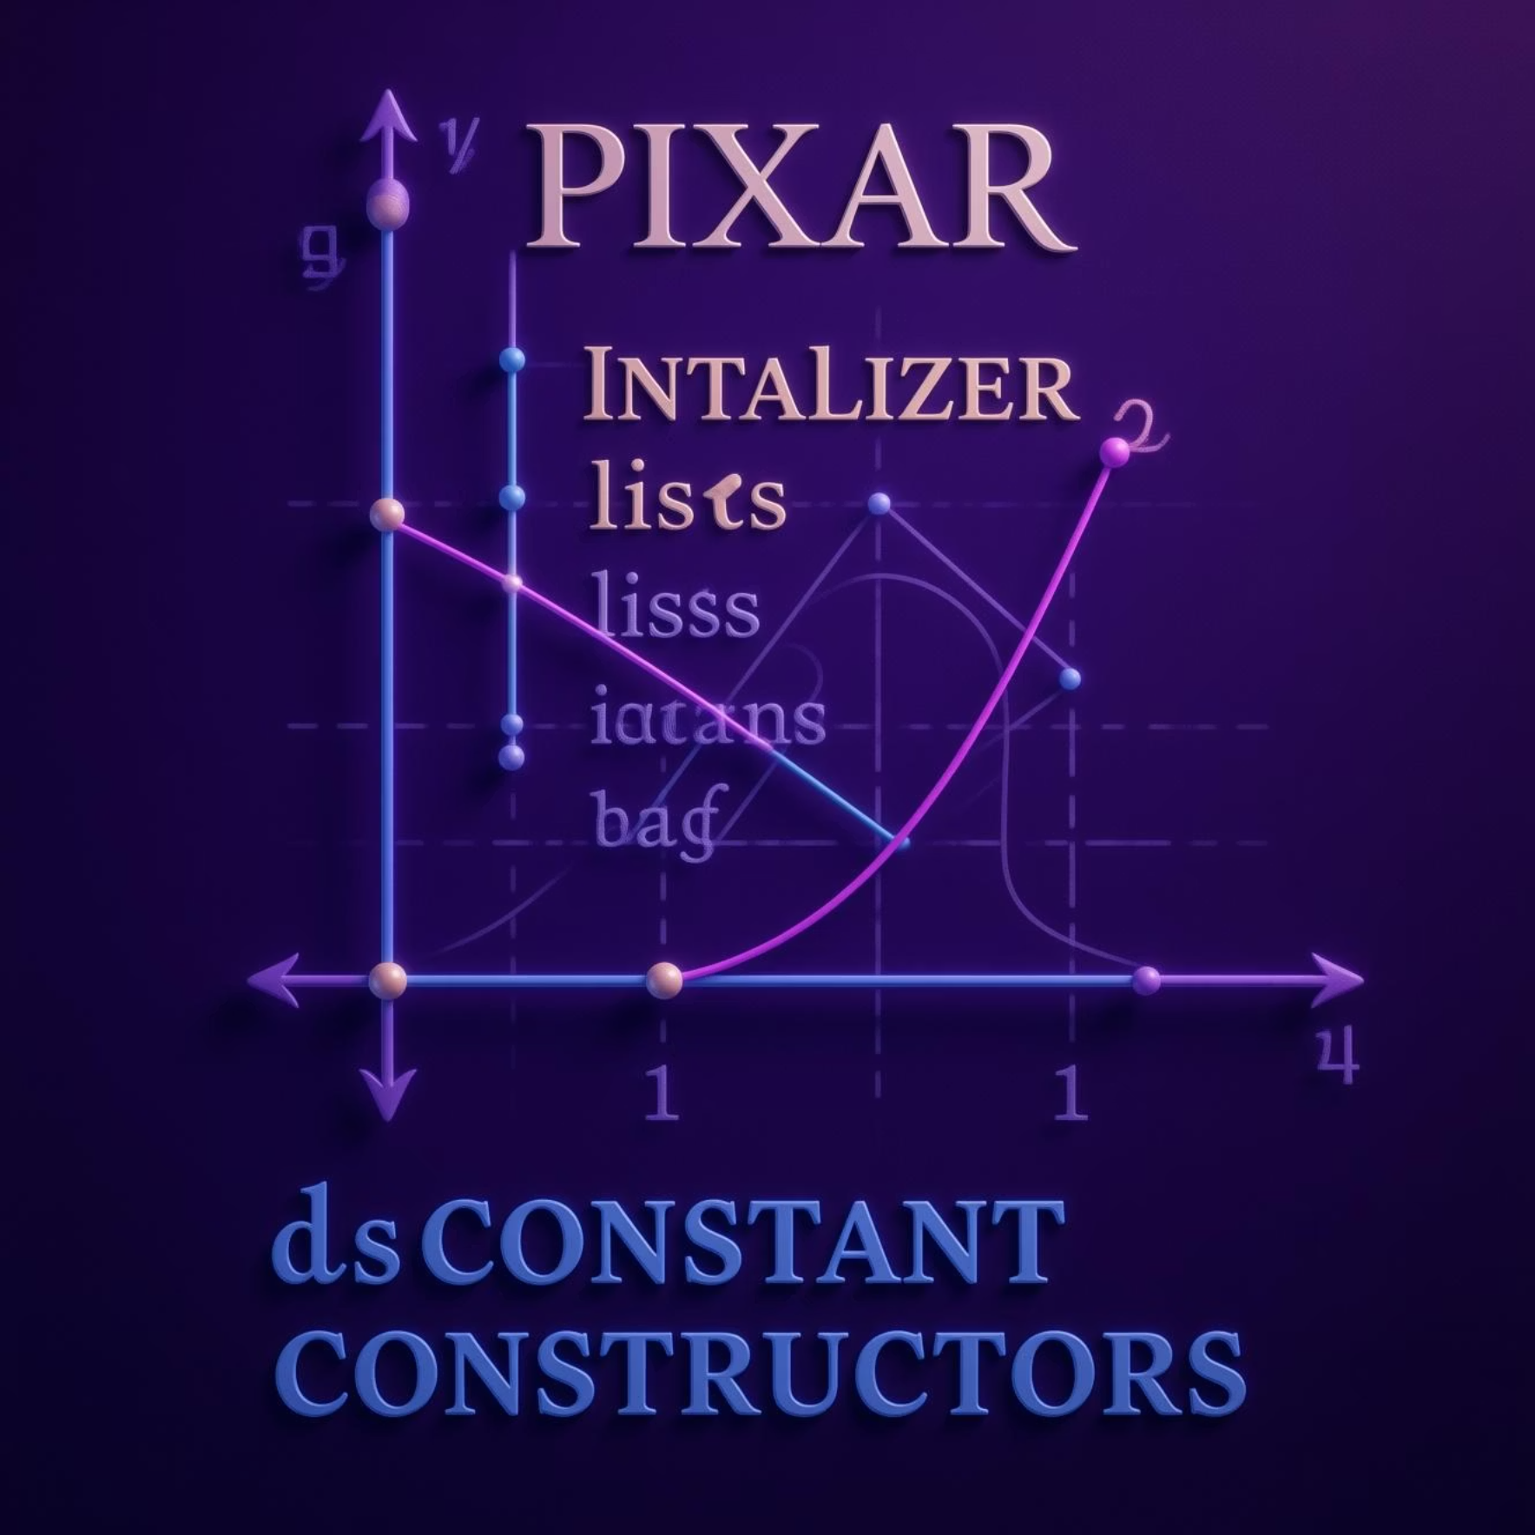
Advanced Constructors: Initializer Lists & Const
Dart offers powerful constructor features for more complex initialization scenarios, such as initializer lists and constant constructors.
class Point {
final double x; // Final properties
final double y;
// Initializer list (runs before constructor body)
Point(double x, double y)
: x = x,
y = y {
print('Point created at ($x, $y)');
}
// Constant constructor (for immutable objects)
const Point.origin()
: x = 0,
y = 0;
}
Initializer Lists
Used to initialize instance variables before the constructor body executes.
Essential for initializing final fields, which must be assigned a value before the constructor body runs.
Also useful for asserting conditions or performing pre-computation for variable initialization.
Constant Constructors
Declared with the const keyword.
Used to create immutable objects that are compile-time constants.
All instance variables in a class with a const constructor must be final.
Promotes performance by allowing Dart to reuse existing constant objects.
Usage
void main() {
Point p1 = Point(3.0, 4.0);
const Point origin = Point.origin(); // Compile-time constant
}

Slide 10

Factory Constructors & Key Takeaways
Factory Constructors
Key Takeaways
Factory constructors in Dart provide a powerful way to control object creation beyond simply instantiating a new object. They are crucial when the constructor itself needs to decide which object to return.
Classes vs. Objects
Return Existing Instances: Can return an already existing instance of the class from a cache, rather than always creating a new one.
Classes define blueprints, while objects are their instances.
Return Subtypes: Can return instances of subtypes.
Complex Initialization Logic: Useful for implementing complex initialization logic that cannot be expressed in a regular constructor.
Constructors
They initialize object states; types include default, parameterized, named, const, and factory.
class Logger { final String name; static final Map<String, Logger> _cache = {}; // Private constructor Logger._internal(this.name); // Factory constructor factory Logger(String name) { return _cache.putIfAbsent(name, () => Logger._internal(name)); } void log(String msg) => print('$name: $msg'); }
Properties
Instance variables store data, with getters/setters for controlled access.
Encapsulation
Use private members (_ prefix) to protect internal data.
Usage:
void main() {
Logger logger1 = Logger('UI');
Logger logger2 = Logger('UI'); // Same instance as logger1
}

